Slide 1
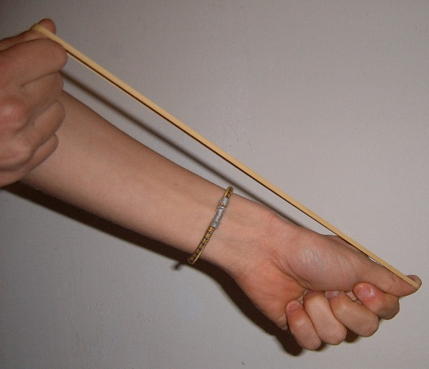
Daily Review
Reminder
When describing a force, you need to include: What is pushing / pulling what Any changes to the objects’ Speed Direction Shape
Describe the force at work in the picture below.
The ________ is pushing / pulling the ________. This is causing the ________ to change ________.
Vocabulary
force (noun) any push or pull that happens when two objects interact applied force (noun) a simple push or pull
Notes:
45 s → share → popsticks

Slide 2

Daily Review
Reminder
When describing a force, you need to include: What is pushing / pulling what Any changes to the objects’ Speed Direction Shape
Describe the force at work in the picture below.
The ________ is pushing / pulling the ________. This is causing the ________ to change ________.
Vocabulary
force (noun) any push or pull that happens when two objects interact applied force (noun) a simple push or pull
Notes:
45 s → share → popsticks

Slide 3
Daily Review
Adding and Subtracting Forces
If two forces are going in the same direction, they are added together.
If two forces are going in opposite directions, they are subtracted.
State the net force and the direction of the force for the examples below.
50 N
300 N
300 N
100 N
100 N
400 N

Slide 4

Daily Review
Describing and Drawing Forces
When describing forces, you need to:
Draw a diagram with labelled force arrows.
Do the maths
Add the forces going in the same direction
Subtract the forces going in opposite directions
Describe the net force
Balanced (there is no net force)
Unbalanced (state the net force and its direction)
Two dogs, Rex and Duke, are fighting over a bone. Rex is pulling with 350 N and Duke is pulling with 275 N.
1.
2.
3.
350 – 275 = 75
The net force is 75 N towards Rex.
275 N
F_{Duke}
350 N
F_{Rex}

Slide 5
Daily Review
Describing and Drawing Forces
When describing forces, you need to:
Draw a diagram with labelled force arrows.
Do the maths
Add the forces going in the same direction
Subtract the forces going in opposite directions
Describe the net force
Balanced (there is no net force)
Unbalanced (state the net force and its direction)
Two people, Zoe and Joe, are pushing a box together across the floor. Zoe is pushing with 500 N and Joe is pushing with 600 N.
1.
2.
3.
500 N
F_{Zoe}
500 + 600 = 1100
The net force is 1100 N to the right.
600 N
F_{Joe}

Slide 6
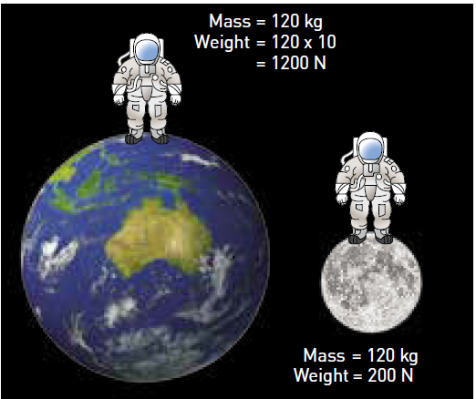
Daily Review
Comparing Gravity
Consider the mass of the objects: more mass = more gravity
Consider the mass of the planets: more mass = more gravity
Consider the distance between the objects: more distance = less gravity
State which object is pulled more (or less) by gravity and explain why.
Vocabulary
mass (noun) the amount of matter (‘stuff’) an object contains gravity (noun) a non-contact force that pulls objects with mass together
The ________ is pulled ____ by gravity because…

Slide 7
Simple Machines: Levers Year 7 Science

Slide 8
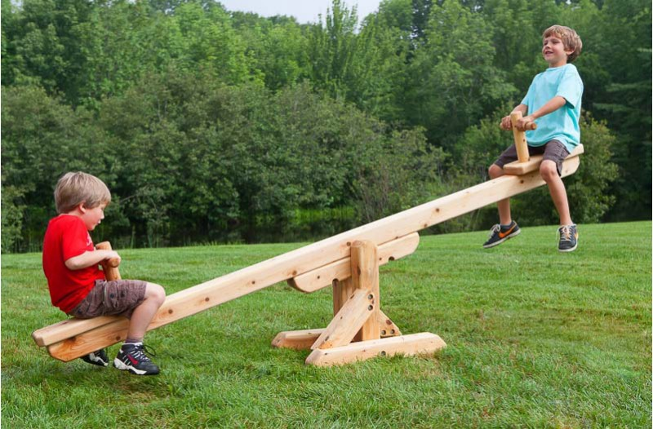
Learning Objectives
CFU
What are we going to learn?
Define and identify levers, fulcrums, input force, and output force.
Describe and calculate mechanical advantage.
Activate Prior Knowledge
Think, pair share:
What does advantage usually mean?
Draw a seesaw on your whiteboards and label the forces at work.
In this picture, which child is experiencing more gravitational force? How do you know? (The two children are not moving.)

Slide 9

Concept Development
CFU 1
What is a lever?
What is a lever?
A lever is a solid rod or bar that is supported at a turning point called a fulcrum.
A seesaw is an example of a lever:
CFU 2
What is a fulcrum?
CFU 3
Think, Pair, Share: what are two other examples of a lever?
fulcrum (turning point)
bar

Slide 10
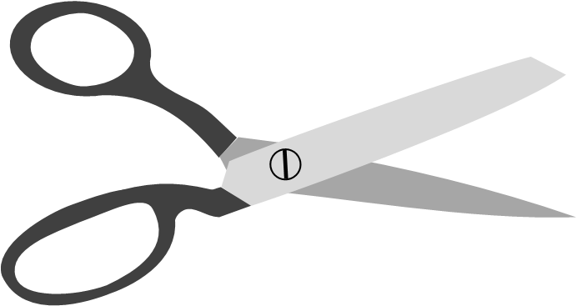

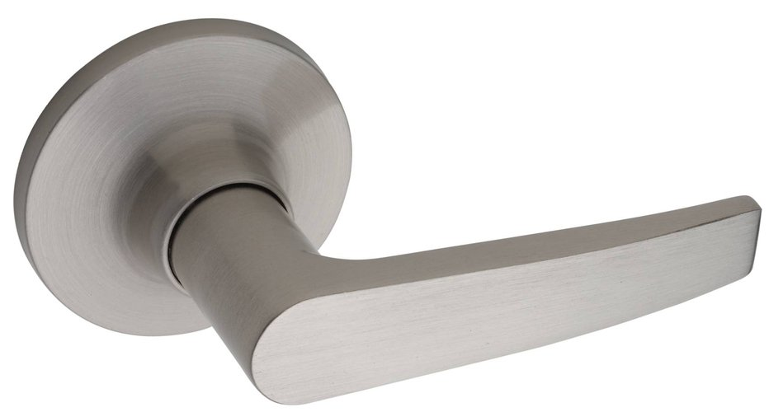
Concept Development
CFU 1
For each of the levers below, label the fulcrum.
What is a fulcrum?
A fulcrum is the turning point of a lever.
CFU 2
Where can the fulcrum be positioned in a lever? at one end the middle both
Vocabulary
lever (noun) a solid rod or bar with a turning point called a fulcrum

Slide 11
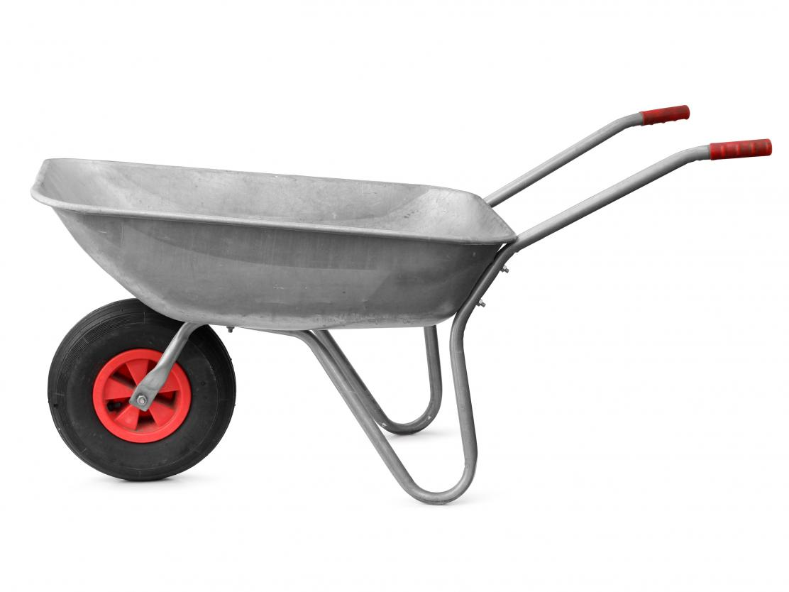
Concept Development
CFU 1
What does a lever do?
What does a lever do?
A lever takes an input force and creates an output force.
Input force is the force used to operate a lever (it is sometimes called effort).
Output force is the force that a lever creates.
CFU 2
Where is the fulcrum in this system?
CFU 3
Where is the input force in this system?
input force
output force
CFU 4
Where is the output force in this system?
Vocabulary
fulcrum (noun) the turning point in a lever
fulcrum (turning point)

Slide 12


Concept Development
CFU 1
For each of the levers below, label the input and output forces.
Finding Input and Output Forces
A lever takes an input force and creates an output force.
Input force is the force used to operate a lever.
Output force is the force that a lever creates.
Vocabulary
lever (noun) a solid rod or bar with a turning point called a fulcrum

Slide 13
Concept Development
CFU 1
Which of the following is true when lifting something normally? input = output input > output input < output
Mechanical Advantage
When you lift something normally, your output force will be the same as your input force.
A lever provides a mechanical advantage, which multiplies your input force to create a larger output force.
CFU 2
Which of the following is true when lifting something with mechanical advantage? input = output input > output input < output
input force:
100 N
output force:
800 N
Vocabulary
lever (noun) a solid rod or bar with a turning point called a fulcrum

Slide 14
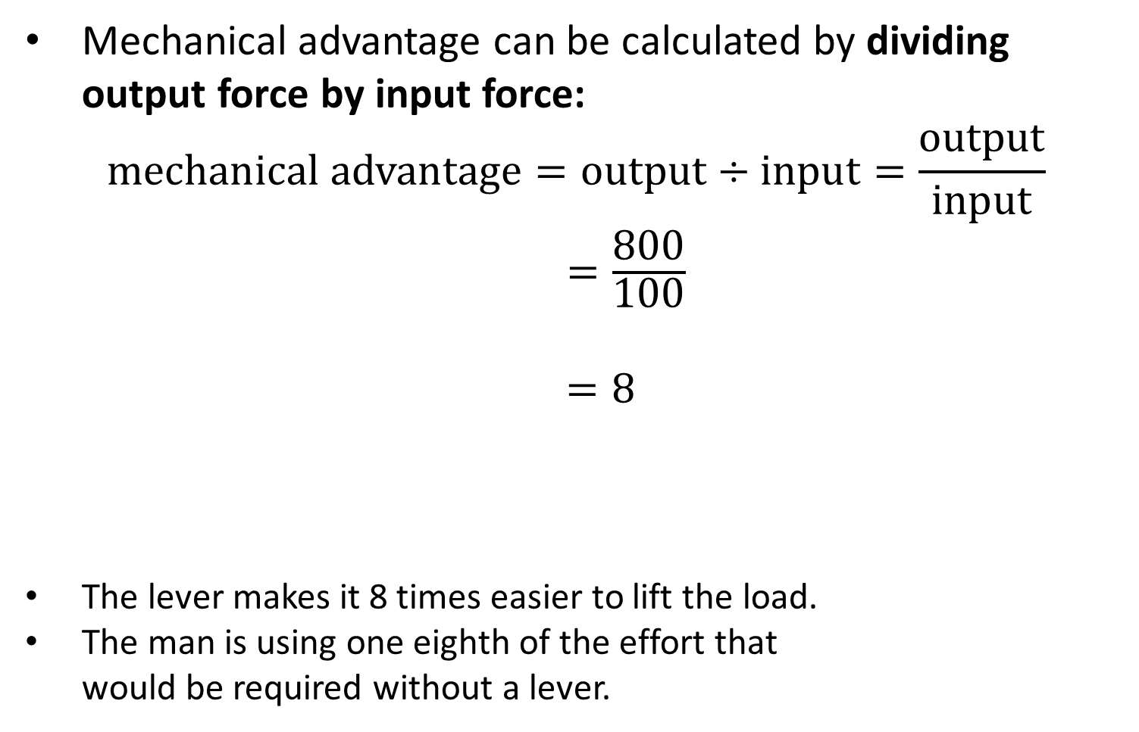
Concept Development
CFU 1
What is the mechanical advantage of this lever?
Mechanical advantage can be calculated by dividing output force by input force:
$$\text{mechanical} \text{advantage}=\text{output}÷\text{input}=\frac{\text{output}}{\text{input}}$$
$=\frac{\text{800}}{\text{100}}$
$=8$
The lever makes it 8 times easier to lift the load.
The man is using one eighth of the effort that would be required without a lever.
Output force:
800 N
input force:
100 N

Slide 15
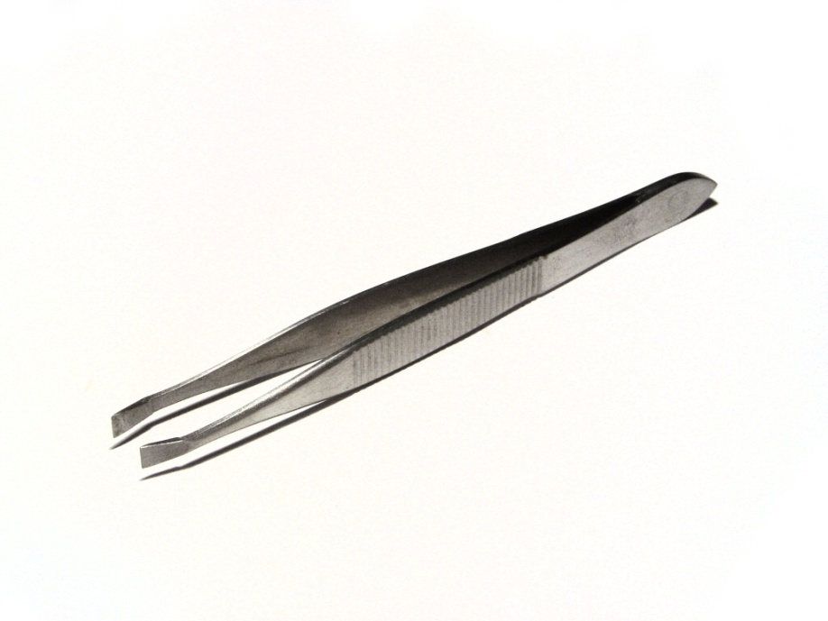
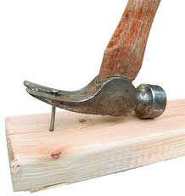

Skill Development / Guided Practice
Labelling Input Force, Output Force, and Fulcrum
Label the input force, output force, and fulcrum on the following levers:

Slide 16
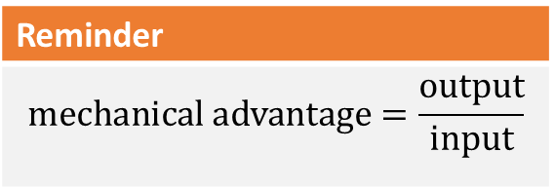
Skill Development / Guided Practice
Calculate the mechanical advantage of the wheel barrow. Show your working.
input force (100 N)
output force (1200 N)
Reminder
$$\text{mechanical} \text{advantage}=\frac{\text{output}}{\text{input}}$$

Slide 17
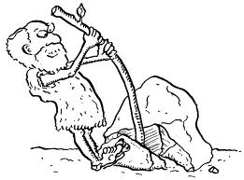
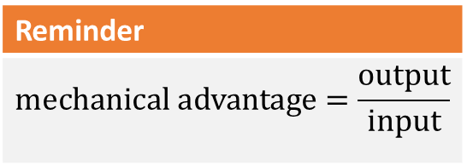
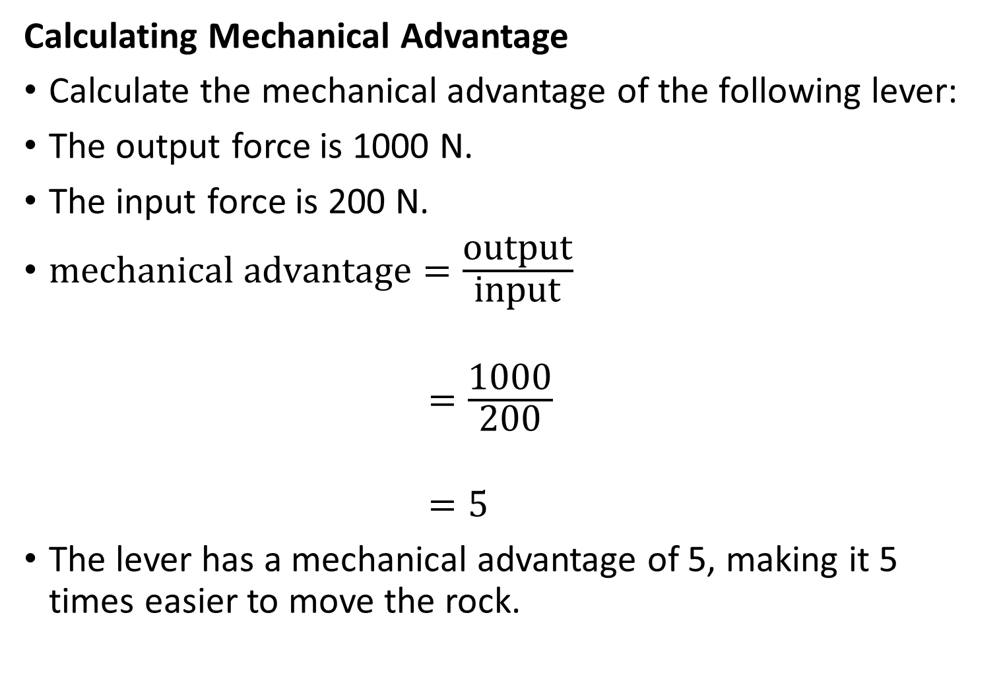
Skill Development / Guided Practice
CFU 1
What is the output force?
Calculating Mechanical Advantage
Calculate the mechanical advantage of the following lever:
The output force is 1000 N.
The input force is 200 N.
$\text{mechanical} \text{advantage}=\frac{\text{output}}{\text{input}}$
$=\frac{\text{1000}}{\text{200}}$
$=5$
The lever has a mechanical advantage of 5, making it 5 times easier to move the rock.
CFU 2
What is the input force?
200 N
1000 N
Reminder
$$\text{mechanical} \text{advantage}=\frac{output}{\text{input}}$$

Slide 18
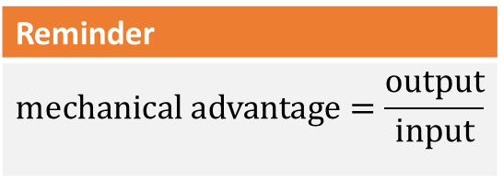
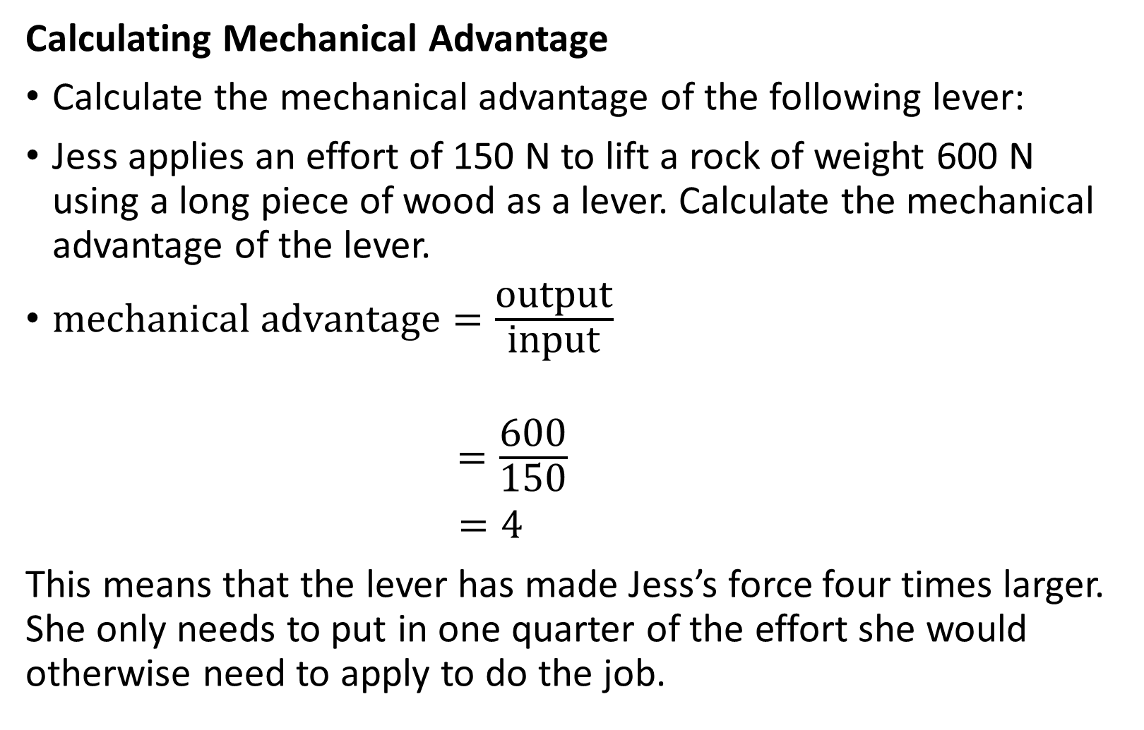
Skill Development / Guided Practice
CFU 1
What is the output force Jess needs?
Calculating Mechanical Advantage
Calculate the mechanical advantage of the following lever:
Jess applies an effort of 150 N to lift a rock of weight 600 N using a long piece of wood as a lever. Calculate the mechanical advantage of the lever.
$\text{mechanical} \text{advantage}=\frac{\text{output}}{\text{input}}$
$=\frac{\text{600}}{\text{150}}$
$=4$
This means that the lever has made Jess’s force four times larger. She only needs to put in one quarter of the effort she would otherwise need to apply to do the job.
CFU 2
What is the input force Jess is exerting?
Reminder
$$\text{mechanical} \text{advantage}=\frac{output}{\text{input}}$$

Slide 19
Relevance
As you’ve already seen, levers are literally everywhere.
Knowing how to use levers can make your life much easier!
Levers are used in construction, engineering, sports, and many other fields.

Slide 20
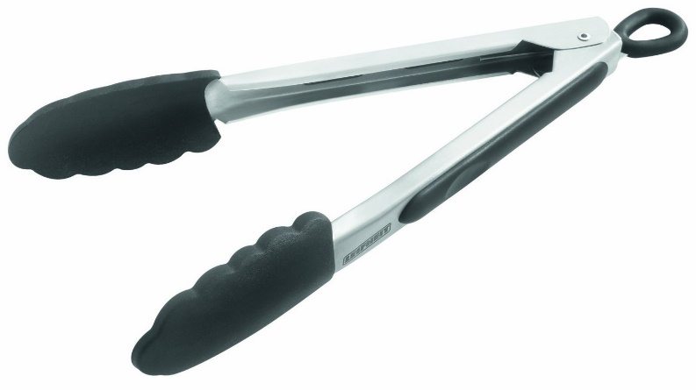

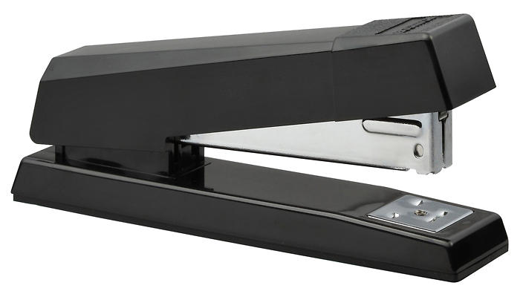
Skill Closure
For the following levers, label the fulcrum, input force and output force.
Reminder
The fulcrum is the turning point in a lever. The input force is the force used to operate a lever. The output force is the force that a lever creates.

Slide 21
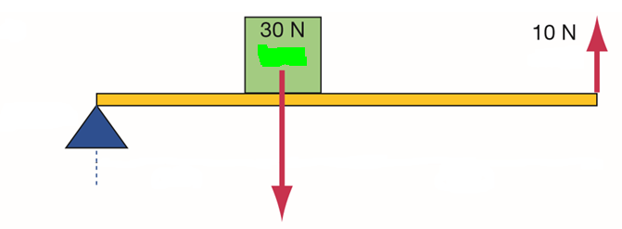
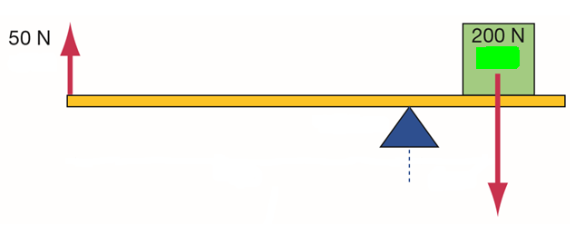

Skill Closure
1. Fill in the blanks: A ________ is a solid _____ or bar that is supported at a turning point called a ________ .
2. Label the effort (input force), load (opposite of output force), and fulcrum on the following levers. Then calculate their mechanical advantage.
Reminder
$$\text{mechanical} \text{advantage}=\frac{output}{\text{input}}$$

Slide 22
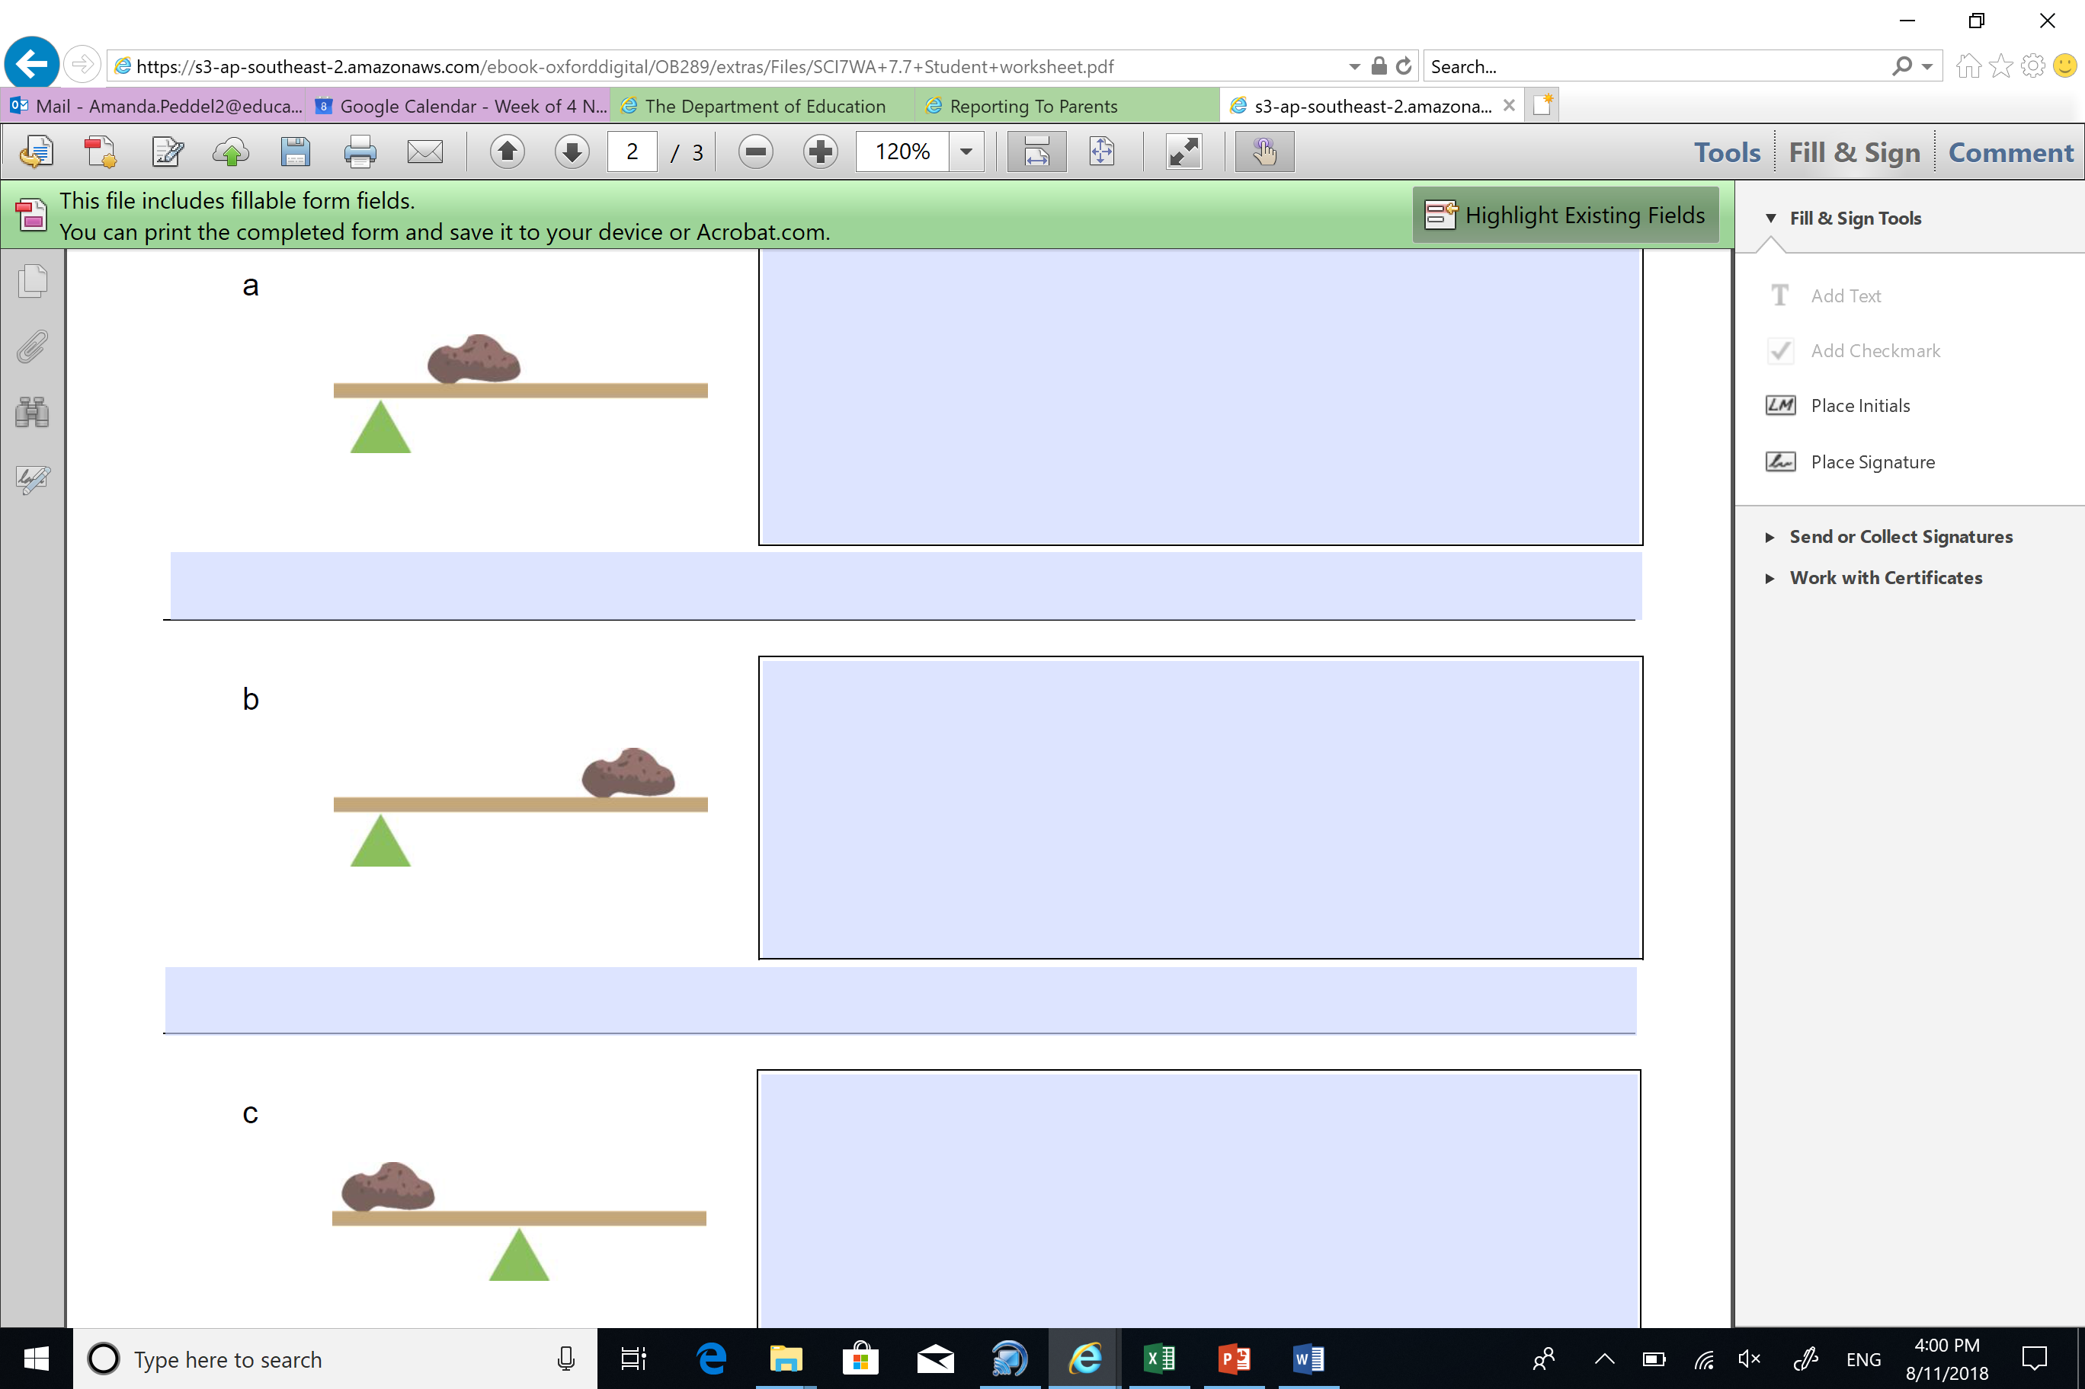
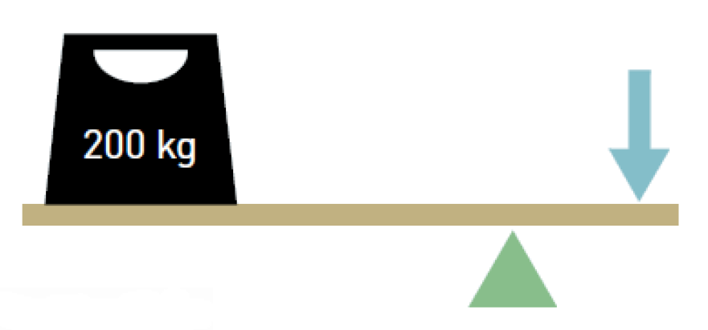
Independent Practice
b
Input force: 100 N
Output force: 600 N
1. For each of the following levers:
Label the fulcrum, output force, and input force
Calculate the mechanical advantage
2. Draw the following lever, labelling output force, input force, and fulcrum. Then calculate its mechanical advantage. A washing machine has a weight of 600 N and requires 200 N of effort to move it using a trolley.
c
Input force: 2 N
Output force: 50 N
a
25 N
N
d
Input force: 15 N
Output force: 75 N

